Slide 1
IPA 101 – how to sound like a beer snob
Notes:
Beer Snob Jargon / IPA 101 – Fundamentals of Beer Snob Jargon/Vocabulary / How to sound like a beer snob

Slide 2
Notes:
Pause couple seconds..
Beer Snob Jargon / IPA 101 – Fundamentals of Beer Snob Jargon/Vocabulary / How to sound like a beer snob

Slide 3
Motivation
WHAT ARE THE ELEMENTS OF A GREAT IPA?
(From the lens of brewers and beer enthusiast)
Notes:
Probably the most popular beer style that have seen an explosion of growth (and in my opinion fuel this explosion of growth) in the last couple decades

Slide 4
Data
www.beeradvocate.com
Top 100 List:
American Style
New England Style
Imperial IPAs
54,746 Reviews
Notes:
Probably the most popular beer style that have seen an explosion of growth (and in my opinion fuel this explosion of growth) in the last decade

Slide 5

ToolS

Slide 6
Methodology
Preprocessing
StopWords
Lemmatization
Topic Modeling (LDA)
Notes:
Latent Dirichlet Allocation
Using LDA ,it is presumed that each review is a mixture of a small number of topics and that each word’s presence is attributable to one of these topics. So based on how often certain words occur within a review, it will probabilistically assign certain topics to each review.

Slide 7
Topics
3
5
10
Notes:
For my LDA model
Set parameters of the model to find top 10 vs. 5 vs. 3 topics
They all converge to the same 3 Main topics, anything in addition were Noise / irrelevant topics

Slide 8
hop, aroma, head, finish
flavor, taste, malt
citrus, grapefruit, fruit
Topic 1: Characteristics of the Beer
Notes:
Words like “ XXXXX “ makes up the dimensions of this topic
Topic 1: Characteristics of the beer (Hop, aroma, flavor, color, taste, tropical/fruity, malts)
Topic 2: Judging the beer (w/ heavy emphasis on Head, as if you were a judge at a homebrewing competition)
Topic 3: How is the beer served? (What kind of glass used when drinking it)

Slide 9
glass, lace, pour
head, finger, retention
Topic 2: Judging/Rating the Beer
color, orange, amber, appearance
Notes:
Words like “ XXXXX “ makes up the dimensions of this topic
Topic 1: Characteristics of the beer (Hop, aroma, flavor, color, taste, tropical/fruity, malts)
Topic 2: Judging the beer (w/ heavy emphasis on Head, as if you were a judge at a homebrewing competition)
Topic 3: How is the beer served? (What kind of glass used when drinking it)

Slide 10
glass, tulip, bottle, growler, bomber,
oz, pint, ounce
date, day
Topic 3: Serving the Beer
Notes:
Words like “ XXXXX “ makes up the dimensions of this topic
Topic 1: Characteristics of the beer (Hop, aroma, flavor, color, taste, tropical/fruity, malts)
Topic 2: Judging the beer (w/ heavy emphasis on Head, as if you were a judge at a homebrewing competition)
Topic 3: How is the beer served? (What kind of glass used when drinking it)

Slide 11
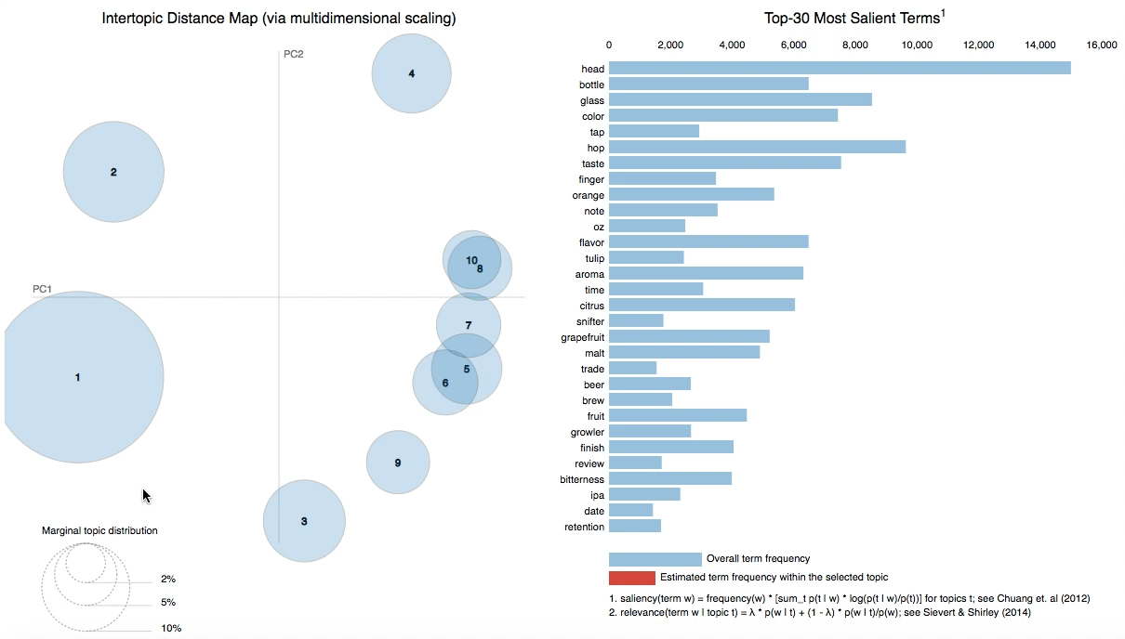
Notes:
- This chart shows the top 30 most influential words found among all of the reviews.
In other words, these are the words that attributed most to the meaning of these topics
The circle indicate the topic number
- Topic 1 encompasses the majority of these words
For Topic 1, Beer Characteristics, the majority of these words accounted for the meaning behind this topic…
For Topic 2, Judging/Rating the beer, …
For Topic 3: Serving the beer,…

Slide 12
TOP Bigrams
Bigram | Count
White head | 6144
Pint glass | 2301
Orange color | 1583
Tropical fruit | 1567
Golden color | 1149
Pours hazy | 1121
Tulip glass | 1118
One best | 1035
Golden orange | 929
Finger head | 914
Notes:
They all fall in line with the 3 main topics

Slide 13
Tulip Glass
Head
Golden Orange color

Slide 14
So what’s the big deal with Foam?
Notes:
Why is head so important?
Head is determined by the composition of the beer: malts, hops, yeast, carbonation
Indication of carbonation
It carries the aroma of the beer
You don’t want too much of it, but you don’t too little nor do you want it to recede too fast
Beer connoisseurs/brewers claims they can tell much by the head and the lacing of the beer
Very inexact science
Different styles of beer has different ”head” profiles

Slide 15
Where’s the hops?
Notes:
Something that was surprising was that the mention of HOPs (which is what IPAs are know for - bitterness) was NOT the most mentioned.
Hops are essentially synonymous with IPAs.
While they indeed appeared quite frequent (highest frequency in topic 1), it wasn't recognized as a topic of its own nor did it show up in the top bigrams
This may be a shortcoming of this model (hops appeared so frequently that it’s importance was not weighted highly)

Slide 16
Conclusion
Notes:
So we all know that flavor, aroma, color and appearance matters when it comes to beers and those are usually emphasized in any type of advertising. HOWEVER…
Head appears to be the most important ”metric” that beer connoisseurs and certainly homebrewers use when describing the quality of a good IPA, and beer in general.
OR it may be the case that beer reviewers want to sound like they know what they are talking about and talking about the HEAD of the beer is a low hanging fruit. Since flavor and body of the beer is a bit harder to describe in good detail (without sounding vague) ALTHOUGH still very important.
They also seem to enjoy talking about the kind of glasses they pour their beers in.
You’ll notice that if you go to a tap room or craft beer bar, diff types of beers get served in different type of glasses
So what does this all mean?
From a brewery or marketer’s perspective you might want to put more emphasis on the head of your beer if you want to appeal to the hardcore fans OR beer snobs
Whether in your description, photos, videos
Pay attention of the type of glass you use when you serve your beers in your tap room or in Marketing/Media materials
Tulip Glasses are best because the curvature helps retain and concentrate the aroma of the beer. Emphasis on serving the beer properly to enjoy the AROMA.
If you are a beer enthusiast or just enjoys drinking beer, and if you are out with friends at a craft beer bar and want to sound like you know what you are talking about talk about the Head! Among other things…

Slide 17
Tulip Glass
Head
Golden Orange color

Slide 18
THANK YOU!
Is it Happy Hour Yet?

Slide 19
Appendix
https://en.wikipedia.org/wiki/Beer_head
https://www.npr.org/sections/thesalt/2017/02/20/515799364/the-haze-craze-beer-lovers-newfound-obsession-with-murky-ipas

Slide 20
TOP Trigrams
Trigram | Count
Finger white head | 544
Poured pint glass | 528
12 oz bottle | 452
Fluffy white head | 450
Poured tulip glass | 314
Thick white head | 305
Golden orange color | 300
White head leaves | 298
Head good retention | 289
Thin white head | 283
Notes:
Mostly about Head, the ones that don’t…

Slide 21
Sentiment Analysis

Slide 22
TSNE

Slide 23
Py-LDA-vis
10-topic:
file:///Users/medfordxie/Desktop/Local_Project_Fletcher/lda_orig_10topic.html#topic=0&lambda=1&term=
5-topic:
file:///Users/medfordxie/Desktop/Local_Project_Fletcher/lda_5topic.html#topic=0&lambda=1&term=
3-topic
file:///Users/medfordxie/Desktop/Local_Project_Fletcher/lda_3topic.html#topic=0&lambda=1&term=

Slide 24
How ipa got it’s Name
India pale ale (IPA) is a beefed-up version of pale ale, made using more hops and with a higher alcohol content. Created in England, the name is a result of its popularity with British troops stationed in India in the 19th century, when the subcontinent was still a British colony https://www.chowhound.com/food-news/55095/what-does-india-have-to-do-with-india-pale-ale/

Slide 25
What is Beer Head?
https://en.wikipedia.org/wiki/Beer_head

Slide 26
Methodology
Explain what a LDA is… (with a visual)
Notes:
Latent Dirichlet Allocation
Presumed that documents cover only a small set of topics and that topics use only a small set of words frequently
Each document is a mixture of a small number of topics and that each word's presence is attributable to one of the document's topics… So based on how often certain words occur within a document, in this case one review, it will probabilistically assign certain topics to each review.
Allows us to find the meaning or the main points or topics of these reviews, so that we know what reviewers are praising about these highly rated beers
Using LDA ,it is presumed that each review is a mixture of a small number of topics and that each word’s presence is attributable to one of these topics. So based on how often certain words occur within a review, it will probabilistically assign certain topics to each review.

